Slide 1

Manchester Middle School
Annual Family Partnership Meeting
2025-2026
Principal: Erica Short
Assistant Principal: Krystal Johnson
Counselor: Randy Gibson
Family Engagement Coordinator: Kristie Battle

Slide 2

What is Title I ?
Title I began in 1965 (ESEA) as a federal program to ensure equal opportunities for low income school districts.
Through Title I, the federal government disburses money to school districts based on the number of low-income families in each district as determined by census data.
The school uses its Title I money to supplement and improve educational programs offered to help ALL students meet state standards.

Slide 3

The Purpose of Title I
. . . is to ensure that ALL students have a fair, equal, and significant opportunity to obtain a high-quality education and reach, at a minimum, proficiency on challenging State academic achievement standards and State academic assessments.

Slide 4
All Meriwether County Schools are Title I Schools!
Title I Schools shall:
Develop a School-Wide Plan
Conduct a needs assessment/parent survey on the types of programs we offer and use parent input to guide our decision making on ways to help students
We hold Parent workshops / presentations to train and inform parents about standards, assessments, etc…
Use Title I Money to provide ALL students with services to help them achieve academic success
We establish goals based on multiple pieces of data and determine how are we going to meet our goals through programs & interventions

Slide 5


Accessibility
We want to make all documents and forms accessible to ALL parents in a manner that is easily read and understood.
Copies of documents/forms can be printed in large format (upon request) and in other languages (upon request).

Slide 6
How MMS uses Title I funds
Family engagement resources for families
Newsletters
Title I Parent Guidebooks
Student Datebooks
Afterschool Tutoring
Technology
Instructional Software
Staff Salaries
Supplemental Programs/Services

Slide 7
School Goals for FY26
By the end of 2026, Manchester Middle School will increase student proficiency in reading and math by at least 3% in overall growth from fall to spring local and state diagnostic and assessments using clear and collaborative practices.
During the 2025-26 school year, Manchester Middle School will provide activities each nine weeks to help (promote) families to become stronger advocates for their scholars’ education.
By the end of the 2025–2026 school year, Manchester Middle School will increase overall student attendance by 2.3% and reduce office discipline referrals by 10% through the implementation of a tiered intervention system, consistent behavior expectations, and student incentive programs that promote positive behavior and regular school attendance.
By the end of 2026 school year, Manchester Middle School will increase student ownership of academic progress by ensuring that all scholars regularly track their individual growth.. Teachers will facilitate student-led data conferences at least once per quarter to promote reflection, accountability, and personalized goal-setting.

Slide 8
College and Career Ready Performance Index ~ CCRPI
Georgia uses the College and Career Ready Performance Index (CCRPI) for state accountability purposes.
The CCRPI is like a REPORT CARD for schools.
CCRPI has multiple indicators to determine a school’s performance, rather than using a single test score given at one point in time.

Slide 9
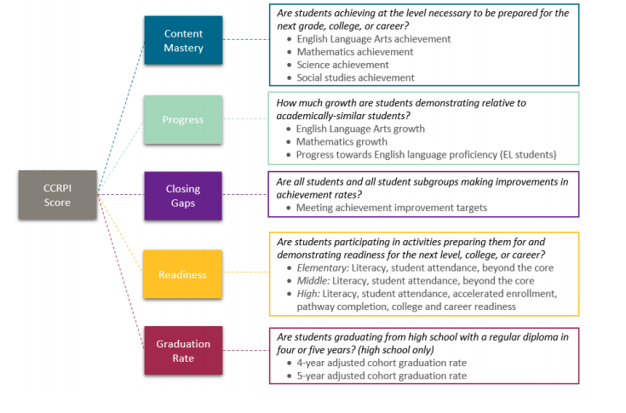
CCRPI measures…

Slide 10
School Curriculum
You can visit the GA DOE website – Georgia Standards to view more information about our standards for instruction and resources available. www.georgiastandards.org
Georgia Standards of Excellence (GSE)
  Standards – for ELA, Math, Social Studies, Science
Additional Information:
Connection Classes
Physical Education
Health
Language Arts Remedial
Business Computer Science/CTAE

Slide 11
Stakeholder Involvement
Stakeholders include: School leaders, teachers, students, parents, family members, community members.
INPUT is valued and appreciated. (Surveys, forums)
  Parent Engagement Plan
  School-Family Compact
  School Improvement Plan
  Building Capacity
  1% Parent Involvement Funds
  (Share with parents copies of the compact, Parent Engagement Plan, School Improvement Plan and where they can find them on the school parent resources room / school website/social media, etc…)

Slide 12
Parent & Family Engagement Plan
This plan outlines how the school will involve parents and help them to help their children be successful.
1% Set Aside funds for Parent Involvement
1% of our Title I money is set aside for parent engagement.
Parent Feedback is obtained through surveys.

Slide 13
School~ Family Compact
The School~Family Compact is the signed agreement between all parties—parent/student/school stating how each party will help students be successful in school.
Building Capacity
Suggestions on ways that the school can best help YOU to help your child succeed at school and home.

Slide 14

Parent Engagement Activities
Get Involved…
Parent Involvement Meetings
Grade Level Meetings
Parent Conferences
School Council
Parent Advisory Committee
PTSO Meetings
Workshops

Slide 15

Communication
School WEBSITE
District WEBSITE
School Newsletters
Social Media
Flyers
OneCALL
Email
REMIND
Infinite Campus
Make sure that we have YOUR current phone number, email address and address on file.

